Slide 1
INVESTOR / BOARD PRESENTATION — AUGUST 2026
TWB — Global Secure Destruction & Demilitarization Platform
Why the world needs mobile demil now — and why TWB is positioned to build the platform
10-Year Growth Plan & Illustrative Go-Public Valuation
Prepared for internal board discussion. Contains illustrative, modeled projections — not a solicitation of investment.

Slide 2
DISCLAIMER
Forward-Looking Statements & Use of Projections
FORWARD-LOOKING STATEMENTS
This presentation includes forward-looking statements regarding estimates and forecasts of financial and performance metrics, projections of market opportunity, and expectations related to a potential future transaction. These statements are based on assumptions that are difficult or impossible to predict and will differ from actual results. Many events and circumstances are beyond TWB's control. Actual results could differ materially from the results implied by these statements.
USE OF PROJECTIONS
This presentation contains projected financial information with respect to TWB. Such projected information constitutes forward-looking information, is included for illustrative purposes only, and should not be relied upon as necessarily indicative of future results. The assumptions and estimates underlying the projections are inherently uncertain. No independent auditor has audited, reviewed, compiled, or performed procedures with respect to the projections, and no opinion or assurance is provided with respect to them.
NO OFFER OR SOLICITATION
This presentation does not constitute an offer to sell or the solicitation of an offer to buy any securities, or a solicitation of any vote or approval, in any jurisdiction.
2

Slide 3
The Problem
Why secure, mobile ammunition destruction is needed now — before the plan, the market, or the valuation
3

Slide 4
THE PROBLEM
Stockpiles Are Growing Faster Than the Capacity to Destroy Them
Three forces are converging: more ordnance to dispose of, fewer places able to do it, and a disposal model that assumes the ordnance can travel.
Post-conflict
Multi-state
Every agency
Clearance & reconstruction
NATO demil backlogs
Police & seized ammunition
Every conflict leaves contaminated land and abandoned stockpiles behind. Every cleared field produces ordnance that still has to be destroyed — safely, locally, at scale — and clearance budgets are now being written at a scale not seen in decades.
Expiring, obsolete and surplus munitions accumulating across member states as rearmament turns over stockpiles. Storage is a cost and a hazard; destruction is deferred for lack of capacity.
Law-enforcement seizures, take-back events and expired duty ammunition accumulate in evidence rooms with no compliant disposal path — a persistent backlog in every jurisdiction TWB has served.
The structural gap: the world's demil capacity is fixed-plant, centralized and permitted over years. Ordnances are distributed, hazardous to move, and accumulating now. Nobody offers a total solution — detection, separation, destruction and reclamation — at the point of need.
4

Slide 5
THE GAP
Fixed-Plant Demil Can't Reach Where Ordnances Are
The incumbent model requires ordnances to be shipped to a permitted depot. For distributed bases, allied nations and post-conflict zones, that is the bottleneck.
DIMENSION | MOBILE SYSTEM (TWB) | FIXED-PLANT DEMIL
Deployment | Mobile / on-site — the unit goes to the ordnance | Fixed depot — ordnance shipped to plant
Time to operational | Days — trailer-deployable, minimal site prep | Months to years — permitted infrastructure
Capital intensity | Low — single-unit capital cost | High — large-scale fixed plant investment
Ideal use case | Distributed bases, allied nations, surge capacity | Centralized national stockpile reduction
Why this matters for the venture: a mobile, low-CAPEX unit is the only form factor that can serve allied militaries, distributed U.S. bases, police forces and reconstruction zones without waiting years for a plant. The U.S. Army has explicitly reserved demil capacity for new entrants (small-business set-asides) — an opening built for exactly this capability.
5

Slide 6
MARKET OPPORTUNITY
A $15bn-a-Year Global Market, Growing Steadily Through Year 10
$15.0bn / yr
$5.2bn / yr
$8.47bn / yr
2026 annual TAM — mine action, EOD, ammo demil, chem weapons, post-conflict clearance
2026 annual SAM — TWB's realistic serviceable slice
Year-10 annual SAM (grown — not static)
All market figures are annual spend, in USD.
What's driving growth
Post-conflict reconstruction Multi-decade clearance programs now being funded; annual disbursement ramping as financing scales
European rearmament Ammunition and EOD equipment spend growing off current conflict-driven cycle
NATO stockpile turnover Ammunition demilitarization backlogs building across multiple member states
Mine action funding pressure Near-flat to declining — a real headwind, priced conservatively into the model
6

Slide 7
PROOF POINT: THE BUYER IS SPENDING
The Largest Demil Market on Earth Is Recapitalizing
Recent U.S. Army awards show sustained, multi-year demand for conventional ammunition demilitarization capacity — real evidence behind the modeled market slide.
MAJOR U.S. ARMY DEMIL / MUNITIONS DEPOTS (ILLUSTRATIVE)
$808.8M
U.S. Army Conventional Ammunition Demilitarization IDIQ program value — multiple awards for demil of 20mm/40mm cartridges, fuzes, mortars, flares, rocket motors and cluster munitions, PoP through 2026–2027.
Rock Island Arsenal
Illinois — contracting command for demil IDIQ
Source: U.S. Army Contracting Command — Rock Island
Hawthorne Army Depot
Nevada — $2.30bn O&M and modernization award
$2.30B
McAlester Army Ammunition Plant
Firm-fixed-price award (June 2026) for operation, maintenance and modernization of Hawthorne Army Depot, including demilitarization of specified ammunition families.
Oklahoma — conventional munitions demil
Blue Grass Army Depot
Source: DoD Contracts, June 9, 2026
Kentucky — chemical and conventional munitions
Letterkenny Munitions Center
Small-business set-asides
Pennsylvania — demil and disposal operations
The Army has explicitly reserved IDIQ capacity to bring new entrants into the demil industrial base — the exact opening a mobile, low-CAPEX capability is designed to fill.
Illustrative — major U.S. conventional munitions demil facilities generally; not a claim of TWB engagement at each site.
Source: U.S. Army Contracting Command — Rock Island
7

Slide 8
Why TWB
The technology, relationships and field position already in place to build the platform on
8

Slide 9
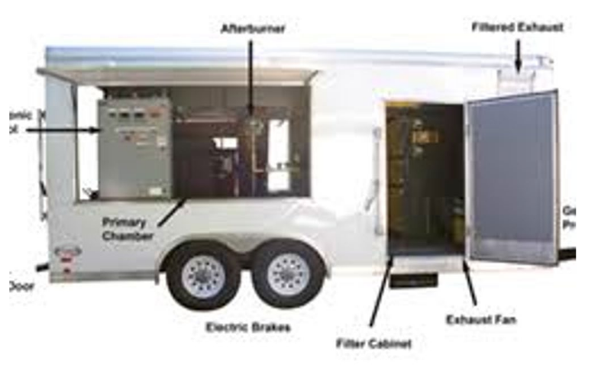
THE CAPABILITY
eMACS / MACS — Mobile Combustion, Field-Proven Since 2001
The deployed platform — not a concept. Co-developed with the Royal Canadian Mounted Police, in continuous service for over two decades.
Two-stage combustion
~850°F primary chamber, ~1,750°F afterburner — clean, low-emission destruction engineered to California EPA and NATO air-handling standards.
Trailer-deployable
11,500 lb towing weight, Class V hitch — on-site in days, not months, versus a fixed-plant build-out.
Armored & interlocked
3/8" plate-steel shell, over-pressure relief, remote start/stop — designed for unattended, field-safe operation.
60 lbs/hr
~1,000 lbs/day
MACS throughput
eMACS capacity
50 CAL
EPA · NATO
Actual eMACS trailer — primary chamber, afterburner, filter cabinet, exhaust fan, filtered exhaust. Source: TWB Designs product documentation.
Max ordnance handled
Emissions standards met
9

Slide 10
THE UNIT ECONOMICS
Every Round Becomes Saleable Metal
Combustion separates ammunition into clean, graded metal streams — turning a disposal cost into a recovery revenue line. Metals recovery is already a proven process, not a modeled hope.
Operator economics
LEAD–ANTIMONY ALLOY
TWB reference: ~1,000 lb of small-arms ammunition per day yields roughly $1,000 of clean reclaimed metal.*
Bullet cores (Pb with ~1–6% Sb) melt at ~620°F and flow to the collection container below the primary chamber.
CARTRIDGE BRASS
Lead + antimony
TWO-STAGE COMBUSTION
~850°F primary · ~1,750°F afterburner
Cases (≈70% Cu / 30% Zn) remain intact in the loading trays — clean, high-value non-ferrous scrap.
Recovered ingot is sought by secondary lead smelters as battery-grade feedstock.
SMALL-ARMS AMMUNITION
live / expired / seized
COPPER / GILDING-METAL JACKETS
Bullet jackets (≈90–95% Cu) separate from cores during combustion and are recovered with the case fraction.
Brass & copper
Cartridge brass and copper jackets are among the highest-value non-ferrous scrap grades.
STEEL & FERROUS
Steel-cased rounds, links and clips separated magnetically from the non-ferrous stream.
Environmental
PRIMER RESIDUE & ASH
Off-gas treated through the ~1,750°F afterburner; process meets California EPA and NATO air-handling standards.
Captured and contained; off-gas treated through the ~1,750°F afterburner and stack.
*TWB Designs press release, 2013 — metal prices vary; figure is indicative only.
10

Slide 11
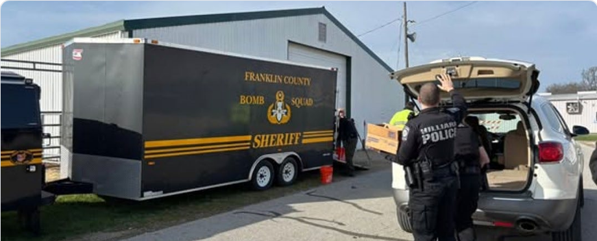
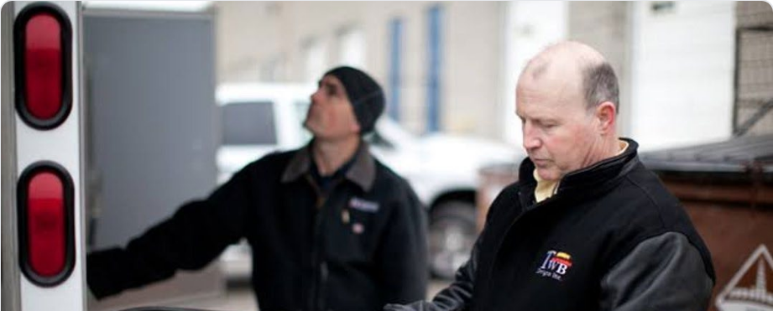
THE POSITION
Two Decades of Deployments and Relationships to Build On
U.S. and Canadian law enforcement, allied and partner-nation military, and government relationships — the platform launches from an existing customer base, not a cold start.
PUBLICLY REFERENCEABLE
Franklin County (OH) Sheriff & Hilliard PD
U.S. law enforcement — take-back events
Royal Canadian Mounted Police (RCMP)
Co-development partner; in service since 2001
Canadian municipal & provincial police
Multiple forces; ongoing disposal programs
Franklin County (OH) Sheriff / Hilliard PD take-back day
TWB operator with remote start/stop unit
Military Equipment Denmark A/S
Exclusive agent — Nordic & Baltic (7 countries)
ALLIED & PARTNER MILITARY
Australian Army
New Zealand Army
Royal Saudi Land Forces
Australian Defence Force — U.S. treaty ally (ANZUS)
New Zealand Defence Force — U.S. treaty ally (ANZUS)
Saudi Arabian Armed Forces — U.S. strategic partner
Deployments with allied and partner-nation forces demonstrate operation to military standards outside Canada. Contract references, scope, and dates available on request.
Recognized by the International Association of Chiefs of Police (IACP) with a Competitive Innovation Award for the eMACS platform.
11

Slide 12
The Venture
Turning a proven mobile capability and an existing partner network into a global secure-destruction platform
12

Slide 13
THE PLAN
Technology Roadmap: From Small Arms to Full-Spectrum Demil
Each stage bolts onto the existing mobile thermal platform rather than replacing it. Enabling tracks run continuously underneath.
Today 2026
Year 1 2027
Year 2 2028
Year 3 2029
Year 10 2036
Small arms through 50 cal
Large-calibre & bombs
Mines, propellants & tactical kit
Remote handling
Chemical weapons
Mobile two-stage thermal (eMACS/MACS)
Metals recovery: lead, brass, copper, steel
Police & military customers, 3 continents
Energetics dissolution front end — licensed from a U.S. university (name TBC)
Separates explosive fill from casing; existing thermal unit treats residues
Opens U.S. Army conventional demil scope
Propellant & rocket-motor demil — different chemistry from HE fill
MIT partnership: metals-discrimination sensing to separate tramp steel from mines/UXO
Tactical equipment product line for EOD & mine-action teams
Robotic feed & cutting for large-calibre and UXO
Enables unattended, field-safe operation at volume
Supports post-conflict clearance tenders
Thermal treatment of chemical agents & munitions
Licensed, OPCW-verified niche
Optionality — not a core pillar
ENABLING TRACKS — CONTINUOUS
Certification & permitting
Metals recovery scale-up
Residuals pathway
Data & traceability
Training & services
EPA/MoE effluent approvals · NATO STANAG · ITAR classification · OPCW
Sorting & grading capacity grows with calibre; MIT sensing dual-use for scrap grading
Dissolution effluent, ash and off-gas treatment closes the environmental loop
Chain of custody, weight-in/out, emissions log, destruction certificates
Operator certification · destruction-as-a-service · equipment sales via agents
13

Slide 14
THE PLAN
One Platform, Four Stages — How the Pieces Fit
Dissolution becomes the front end, the proven thermal unit becomes the back end, and metals recovery closes the loop. Sensing and robotics feed the front; certification and data wrap the whole chain.
SENSE & RECOVER
SEPARATE
DESTROY
RECLAIM
Year 2–3
Year 1–2
Today
Today, scaled
MIT metals-discrimination sensing separates tramp steel from mines and UXO in the field; remote handling and robotic feed move ordnance safely into the process.
Energetics dissolution (U.S. university licence, TBC) removes explosive fill from large-calibre shells and bombs. Propellant and rocket-motor chemistry added Year 2.
Two-stage mobile thermal (eMACS/MACS) — in service since 2001 — treats small arms directly and energetic residues from dissolution. Thermal chem-agent treatment at Year 10.
Lead, brass, copper and steel graded and sold into domestic supply chains. Sorting capacity scales with calibre; sensing tech is dual-use for scrap grading.
Mine action · EOD · tactical equipment
Conventional demil · Army IDIQ scope
Small arms · residues · chem (Y10)
Recovery revenue in every geography
Wrapping the chain: certification gates at every stage (EPA/MoE, NATO STANAG, ITAR, OPCW), a residuals pathway for effluent, ash and off-gas, and a traceability layer — chain of custody, weight-in/out, emissions logging, destruction certificates — that makes multi-country operation auditable. Delivered through three commercial models: destruction-as-a-service, equipment sales via agents, and operator training.
14

Slide 15
THE PLAN
From North American Base to Global Platform
Canada and the United States today; global expansion from 2028, sequenced against the technology roadmap and led by existing partners and relationships.
Canada & USA
Global expansion
Specialist niches
Today
From 2028
Later years
RCMP co-development partner; Canadian police disposal programs
U.S. law-enforcement deployments; no ITAR barrier for a Canadian operator
eMACS already CA-EPA aligned; Army small-business set-asides open to new entrants
Europe / NATO — Nordic & Baltic agent already in place; ammunition demil + EOD services as certification base builds
Post-conflict clearance markets — competitive tenders as sensing and remote-handling capability comes online
Middle East and allied partners — building on existing Australian, New Zealand and Saudi deployments
Chemical weapons demilitarization — licensed, OPCW-verified thermal treatment
Optionality on the platform, not a core pillar
Entered only once core geographies are established
Plus: metals recovery — post-mission material (brass, steel) reclaimed and sold into domestic metals supply chains, converting a disposal cost into a recovery revenue line across every geography.
15

Slide 16
THE 10-YEAR PLAN
Revenue Build: Organic Growth + Acquisition Program
Organic contract-win growth reaches a meaningful base by Year 10. A funded acquisition program adds substantially on top.
~$3–4M
~$30M
~$120–130M
~$220–230M
~$320–340M
~$450–500M
Y0
2026
Y2
2028
Y4
2030
Y6
2032
Y8
2034
Y10
2036
Acquisition program
Year-10 team
Acquisitions front-loaded Years 2–8, continuing through Year 12
Average acquired revenue at entry: ~$15–20M
Post-acquisition growth rate: 15%/year
A majority of Year-10 revenue comes from acquired businesses
~2,300
~5–6%
Approx. total FTE at Year 10
Implied Year-10 SAM share
Pace matters as much as volume: deals made early compound for years; deals made late barely contribute. Real execution running even 1–2 years behind this schedule falls well short of the target.
16

Slide 17
Valuation Lens
Valuation methodology and the discounted future value bridge
17

Slide 18
VALUATION FRAMEWORK
How We're Sizing a Future Valuation
A standard growth-stage go-public valuation approach, applied to TWB on a 10-year basis.
1
Build a comp universe
Named public companies in TWB's own sector — aerospace & defense services
2
Take the comp EV/EBITDA multiple
Public comps: 11.4x. Private/strategic deals: 19.0x
3
Apply it to future EBITDA
Multiply the comp multiple by TWB's OWN Year-10 EBITDA estimate from the operating model
4
Discount back to today
Discount the future firm value back 10 periods — matching the 10-year projection horizon
5
Use as the reference point
The resulting fair value is the anchor against which any future deal price is assessed
Why 10 years, and not fewer: discounting a distant future estimate back FEWER periods than the years actually being projected mechanically inflates the implied fair value. Matching the discount window to the projection horizon avoids manufacturing an artificially large "discount to fair value" headline.
18

Slide 19
APPLYING THE FRAMEWORK
TWB's Comp Universe
TWB has no direct, liquid public comp set for small-arms/ammunition destruction specifically — this uses the closest genuine proxy rather than fabricating a broad universe that doesn't exist.
Cadre Holdings (NYSE: CDRE)
American Battery Technology Co. (NASDAQ: ABAT)
The fundamentals anchor
The story-premium anchor
$685.7M
~2.1x
~$9.5M
~40.3x
TTM Revenue
EV / Revenue
TTM Revenue
EV / Revenue
EOD equipment, body armor, law enforcement/first-responder markets, active buy-and-build M&A strategy. Mature, profitable, trades on real fundamentals (P/E ~42x). This is what TWB might look like AFTER the growth story plays out.
Critical minerals/battery recycling, deeply negative EBITDA, tiny actual revenue, richly valued on narrative and government-grant backing. Shows how much multiple a compelling early-stage story can command on Nasdaq today.
19

Slide 20
THE BRIDGE, APPLIED
Discounted Future Value Bridge — TWB, Year 10
Comp multiple applied to Year-10 EBITDA, discounted 10 periods — matching the projection horizon exactly.
Year-10 revenue (operating model)
$480.5M
Assumed EBITDA margin at scale
20%
Implied Year-10 EBITDA
$96.1M
Comp multiple range (public / private A&D)
11.4x — 19.0x
Future firm value range
$1,095M — $1,826M
Discounted 10 periods @ 20% (matches projection horizon)
Implied discounted fair value — midpoint
$235.9M
The discount period is deliberately matched to the 10-year projection horizon. Discounting over a shorter, mismatched window (e.g. 3 periods) would have shown ~$845M — roughly 3.6x higher — from a methodological shortcut alone. This model does not take that shortcut.
20

Slide 21
Where This Leaves Us
The need: ordnances accumulating faster than fixed-plant capacity can absorb them; the U.S. Army alone has committed over $3bn across its 2026–27 demil awards and opened the door to new entrants
The position: field-proven since 2001, existing police, allied-military and agent relationships across three continents
The plan: organic growth + a funded acquisition program to ~$450–500M revenue by Year 10
The valuation lens: a standard, sourced go-public methodology, applied on a matched 10-year basis
The decision: capital deployment and M&A execution capability, more than market size or story
See the accompanying supporting memo and TWB_10-15yr_Forecast.xlsx workbook for the full model, assumptions, and sourcing.

